Slide 1
San Bernardino Community College District Strategic Planning
Orientation and Update
Board of Trustees Study Session
June 27, 2013

Slide 2
Goal and Learning Outcomes
The Board should be able to:
Describe and discuss the approach, components, and schedule of the District’s strategic planning process
Describe and discuss what the District has accomplished and what is left to accomplish regarding the strategic planning process
Describe and discuss the identification of connections and relationships of environmental scan examples and how they apply

Slide 3
Agenda
What strategic planning is
What strategic planning is not
What strategy is: Southwest Airlines
Keys to effective strategic planning
Role of the Board of Trustees and district staff
Progress and schedule of the strategic planning process
Mission
Vision

Slide 4
Agenda
Values
Strengths
Weaknesses
Opportunities
Environmental Scan
Progress and schedule of the strategic planning process
Questions

Slide 5
What Strategic Planning Is
Systematic process through which an organization agrees on
Builds commitment among key stakeholders
Identifies priorities that are essential to our mission and are responsive to the environment
Comprehensive view by focusing on the “big picture,” but it also leads to specific, targeted actions
Guides the acquisition and allocation of resources to achieve these priorities
Is flexible and practical

Slide 6
What Strategic Planning Is Not
It is not a panacea
Strategic planning does not predict the future
It is not a substitute for the judgment of leadership
It is rarely a smooth, predictable, or linear process

Slide 7
What Strategy Is: Southwest Airlines
"Southwest, the low-fare airline"
Very low ticket prices
Frequent, reliable departures
Limited passenger service
No connections with other airlines
No meals
No seat assignment
Flexible union contracts
High compensation of employees
Business Strategy
Business Strategy
Service Strategy
Service Strategy
Service Strategy
Service Strategy
Service Strategy
Human Resources Strategy
Human Resources Strategy

Slide 8
What Strategy Is: Southwest Airlines
High level of employee stock ownership
Lean, highly productive ground and gate crews
Standardized fleet of 737 aircraft
Short-haul, point-to-point routes between midsize cities and secondary airports
High aircraft utilization
15-minute gate turnarounds
Automatic ticket machines
Limited use of travel agents
Human Resources Strategy
Human Resources Strategy
Operations Strategy
Operations Strategy
Operations Strategy
Operations Strategy
Operations Strategy
Operations Strategy

Slide 9
Keys to Effective Strategic Planning
Focus on the most important issues during the strategic planning process
Be willing to question both the status quo and sacred cows
Produce a document
Make sure the strategic plan is translated into an annual operating plan

Slide 10
Roles of the Board of Trustees and District Staff
Board of Trustees
Administrative Procedure 3250 – Integrated Planning
The Board may assist in developing the general institutional mission and goals for the comprehensive plans through a variety of means, including, but not limited to, the Chancellor’s evaluation process, the Board/Chancellor retreat, and any time the Board reviews curriculum items.
Mission, vision, values, goals
District Staff
Strategies
Annual Plans

Slide 11
Progress and Schedule of the Strategic Planning Process
 | Step | Who | When
1 | Get ready, planning for strategic planning | District Strategic Planning Committee (DSPC) | Complete
2 | Draft mission, vision, values | DSPC | Complete
3 | Assess situation
 | Gather strengths, weaknesses, opportunities, and threats (SWOT) and environmental scan information | DSPC | Complete
 | Discuss draft mission, vision, values, SWOT, and environmental scan information, and goals | Board of Trustees (BOT) and DSPC | July 2013
4 | Agree on priorities, integrate with campus plans
 | Make sense of the data, draft goals | BOT and DSPC | September 2013
 | Draft strategies (SBVC and CHC campus review and input) | DSPC | October 2013
5 | Draft final plan (mission, vision, values, goals, and strategies) and submit to BOT for approval | DSPC | December 2013
6 | Implement plan
 | Develop annual operating plan | District Staff | March 2014
7 | Evaluate and monitor strategic plan | BOT and District Staff | Fall 2015

Slide 12
Mission
The mission statement describes the District's "reason for being, why we are here, and what our purpose is”
Wal-Mart: Saving people money to help them live better
Walt Disney: Committed to produce unparalleled entertainment experiences based on the rich legacy of quality creative content and exceptional storytelling

Slide 13
Mission
Strategic Planning Discussions
Community College
Community College
City of Santa Monica
2010 Population: 89,736
Santa Monica College 2010-11 FTES: 22,545
25% of the population goes to SMC (not true)
8.5% International students
SBCCD Service Area Cities
2010 Population (SB, LL, Colton, Rialto, Highland, Redlands, Yucaipa): 557,728
SBCCD 2010-11 FTES: 15,189
2.7% of the population goes to SBCCD (true?)
Notes:
Santa Monica Population 2010: 89,736
Santa Monica College FTES 2010: 22,545
San Bernardino Population 2010: 209,924; Redlands: 68,747; Colton: 52,154; Rialto: 99,171; Highland: 53,104; Yucaipa: 51,367; Loma Linda: 23,261
SBCCD FTES: 15,189

Slide 14
Mission
ACCJC says, “An institutional governing board is not a City Council…City Councils often act to dole out ‘rewards’ to their electorate; a college governing board member’s job is to focus on achieving educational effectiveness within the bounds of the institution’s mission and available resources.”
SBCCD Mission: We transform lives through education [of our students] for the benefit of our diverse communities (draft)
Notes:
Santa Monica Population 2010: 89,736
Santa Monica College FTES 2010: 22,545
San Bernardino Population 2010: 209,924; Redlands: 68,747; Colton: 52,154; Rialto: 99,171; Highland: 53,104; Yucaipa: 51,367; Loma Linda: 23,261
SBCCD FTES: 15,189

Slide 15
Vision
The vision statement has two parts:
10-to-30 year big and hairy audacious goal (BHAG)
Vivid descriptions of what it will be like to achieve the goal
BHAG – should be so exciting in its own right that it would continue to keep the district motivated even if the leaders who set the goal disappeared. It requires a certain level of unreasonable confidence and commitment
Ford (1900s) – Democratize the automobile
Stanford (1940s) – Become the Harvard of the West
NASA (1960s) – Moon Mission

Slide 16
Vision
Vivid Descriptions
Ford (1900s)
Build a motor car for the great multitude
It will be so low in price that no man making a good salary will be unable to own one and enjoy with his family the blessing of hours of pleasure in God’s great open spaces
When I’m through, everybody will be able to afford one, and everyone will have one
The horse will have disappeared from our highways, the automobile will be taken for granted
We will give a large number of men employment at good wages

Slide 17
Vision
Draft BHAG – SBCCD will be most known for student success
Draft Vivid Description
Our educational programs and services will be highly sought after
Our students will be the most sought after by four-year institutions and employers
Our transfer students will have the highest graduation rates at four-year institutions
Our students will have the highest employment rates in our communities
Our district will be the gateway to pathways and opportunities for a brighter future

Slide 18
Values
Essential and enduring tenants of the district
A small set of guiding principles that require no external justification
Have intrinsic value and importance to those inside the district
They define for us what we stand for

Slide 19
Values
Nordstrom’s
Service to the customer above all else
Excellence in reputation
United States Marine Corp
Honor
Courage
Commitment
SBCCD (Draft)
Service
Integrity
Collaboration
Innovation
Quality

Slide 20
Strengths
Strong faculty/student relationships
Most care about student success
Lessons learned through accreditation
Financial reserve
Good research capabilities throughout the District
Good student involvement
Culture that believes in evidenced-based decision making
Established in the community
Diversity of staff and students
Able to come together and accomplish great things
Passionate and dedicated employees
Exhibits innovation in working with limited resources
Believe we can take risks and make change
Bond funds

Slide 21
Weaknesses
Inability to attract and retain given salary schedule
Multiple systems that are not integrated
Lack of capacity to handle basic/development skills students
District processes are slow
Lack of accountability
Inadequate staffing levels in certain areas (FT faculty)
Lack of attendance at campus events
Lack of communication
Current funding allocation model
Student success
Lack of centralized orientation/training for employees

Slide 22
Opportunities
Demand for transfer students
Need for employees in health care, technology, and sustainability fields
Need for students who are prepared for college
Massive Open Online Courses (MOOCs)
Driving force for the City of San Bernardino recovery
K-16 schools collaboration/partnerships
Grants
Collaboration with community leaders and politicians
Internships for students
Rapid technology change (new programs, methods, and online training)
Alumni
Donors
Marketing/change public image
California economic recovery

Slide 23
Environmental Scan
Example – SBVC Study Area: Population by Race and Ethnicity
Hispanic Total Population 2012: 51%
SBVC Student Population 2011-12: 56%
Nationally:
35.5 million residents in 2000
50.4 million residents in 2010
130 million residents forecasted by 2060
Purchasing Power
$1 trillion in 2010
$1.5 trillion forecasted by 2015

Slide 24
Environmental Scan
Example – SBVC Study Area: Population by Race and Ethnicity
Example Opportunities?
Major educational player for Hispanic employers
Entertainment industry (Telemundo, Univision, radio, newspapers, etc.)
Hospitality industry
Health care industry
Example Goal: Become the educational capital for Hispanic learners

Slide 25
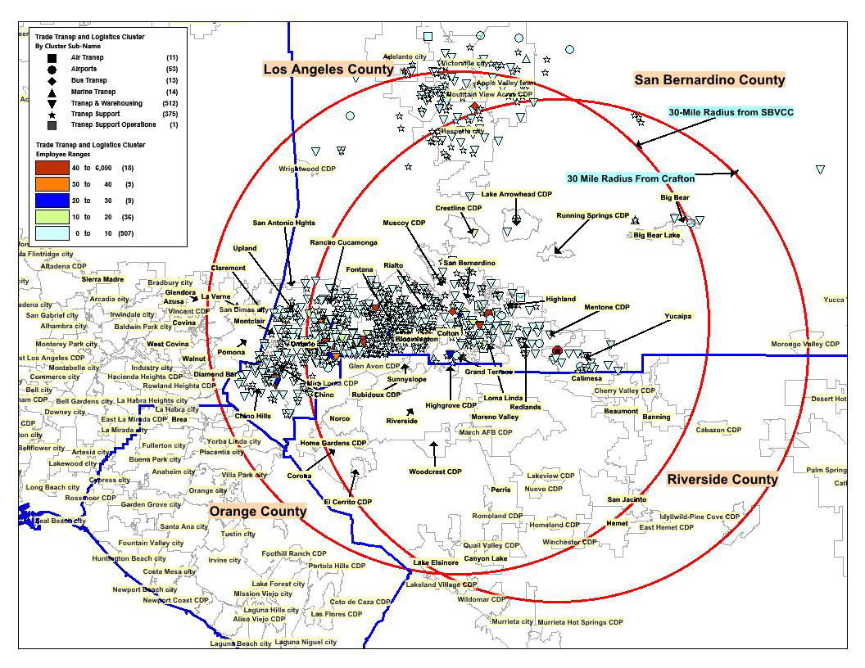
Environmental Scan
Example – Transportation and Logistics

Slide 26
Environmental Scan
Example – Transportation and Logistics – 979 establishments employing 12,423 employees within a 30 mile radius of SBVC/CHC
Example Opportunities?
Articulation agreements with colleges and universities who confer Transportation and Logistics Bachelor’s degrees
Partner with California State University, San Bernardino to offer a Transportation and Logistics Bachelor’s degree with priority transfer privileges
Example Goal: Become the educational capital for transportation and logistics

Slide 27
Progress and Schedule of the Strategic Planning Process
 | Step | Who | When
1 | Get ready, planning for strategic planning | District Strategic Planning Committee (DSPC) | Complete
2 | Draft mission, vision, values | DSPC | Complete
3 | Assess situation
 | Gather strengths, weaknesses, opportunities, and threats (SWOT) and environmental scan information | DSPC | Complete
 | Discuss draft mission, vision, values, SWOT, and environmental scan information, and goals | Board of Trustees (BOT) and DSPC | July 2013
4 | Agree on priorities, integrate with campus plans
 | Make sense of the data, draft goals | BOT and DSPC | September 2013
 | Draft strategies (SBVC and CHC campus review and input) | DSPC | October 2013
5 | Draft final plan (mission, vision, values, goals, and strategies) and submit to BOT for approval | DSPC | December 2013
6 | Implement plan
 | Develop annual operating plan | District Staff | March 2014
7 | Evaluate and monitor strategic plan | BOT and District Staff | Fall 2015

Slide 28
Questions?

